Slide 1
SUSPENSION SYSTEM
(CUSHION FOR PASSENGERS)

Slide 2
INTRODUCTION
Suspension system is the term given to the system of springs, shock absorbers and linkages that connects a vehicle to its wheels . It is basically cushion for passengers protects the luggage or any cargo and also itself from damage and wear.
Sir William Brush is the father of suspension system in automobiles.

Slide 3
ROLE OF SUSPENSION SYSTEM
The main role of suspension system are as follows:
    It supports the weight of vehicle .
    Provides smoother ride for the driver and passengers i.e. acts as cushion.
    Protects your vehicle from damage and wear .
    It also plays a critical role in maintaining self driving conditions.
    It also keeps the wheels pressed firmly to the ground for traction .
    It isolates the body from road shocks and vibrations which would otherwise be transferred to the passengers and load.

Slide 4
PRINCIPLE OF SUSPENSION
Principle :-When a tire hits an obstruction, there is a reaction force. The size of this reaction force depends on the unsprung mass at each wheel assembly.
In general, the larger the ratio of sprung weight to unsprung weight, the less the body and vehicle occupants are affected by bumps, dips, and other surface imperfections such as small bridges. A large sprung weight to unsprung weight ratio can also impact vehicle control.

Slide 5
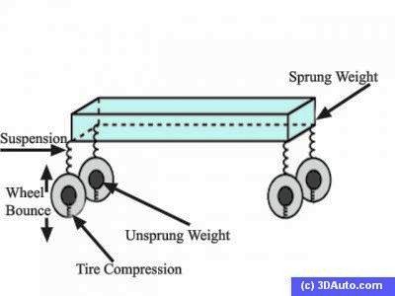
DEFINITIONS OF
SPRUNG &UNSPRUNG MASS
Sprung mass :-Sprung mass (weight) refers to vehicle parts supported on the suspension system, such as the body, frame, engine, the internal
components, passengers, and cargo.
Unsprung mass :- Unsprung mass
refers to the components that follow
the road contours, such as wheels, tires,brake assemblies, and any part of the steering and suspension not supported by the springs.

Slide 6
WORKING OF SUSPENSION SYSTEM
No road is perfectly flat i.e. without irregularities. Even a freshly paved highways have subtle imperfections that can be interact with vehicle’s wheels. These are the imperfections that apply forces on wheels.
According to Newton ‘s law of motion all forces have both magnitude and direction.
A bump in the road causes the wheel to move up and down perpendicular to the road surface. The magnitude of course ,depends on whether the wheel is striking a giant bump or a tiny speck. Thus, either the wheel experiences a vertical acceleration as it passes over an imperfection.

Slide 7
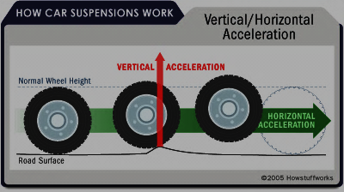
The below figure shows Horizontal/Vertical Acceleration:

Slide 8
PARTS OF TYPICAL SUSPENSION
The suspension of a car is actually part of the chassis, which comprises all of the important systems located beneath the car's body. These system include :
    Frame
    Suspension system
    Steering system
    Tires or Wheels

Slide 9
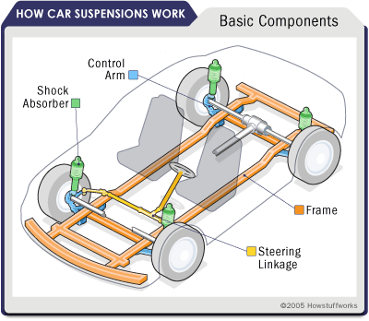
The basic components of car suspension system shown by figure :

Slide 10
COMPONENTS OF ANY SUSPENSION
There are three fundamental components of any suspension system .
    Springs
    Dampers
    Anti sway bars

Slide 11
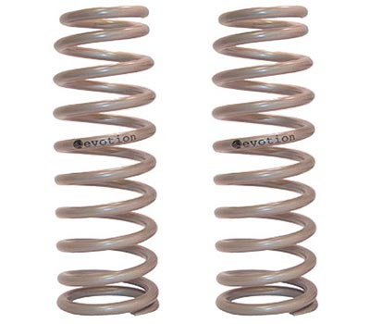

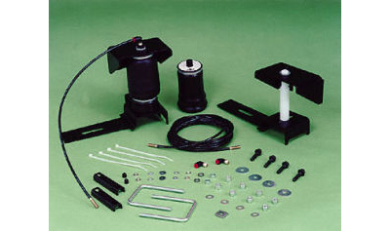
SPRINGS
Coil spring
Leaf springs
Air springs

Slide 12
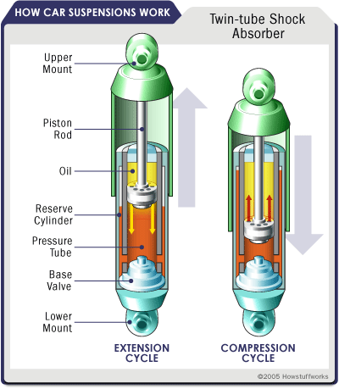
DAMPERS
Three types:-
Shock Absorbers:-

Slide 13
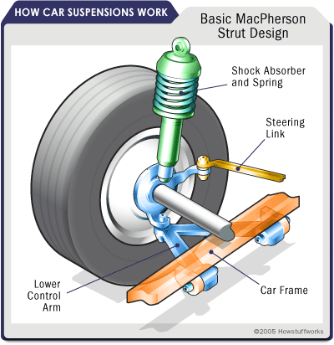
Struts:-

Slide 14
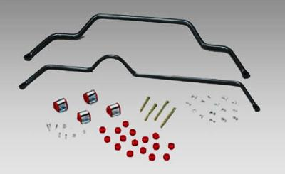
Anti-sway Bars:- Anti-sway bars (also known as anti-roll bars) are used along with shock absorbers or struts to give a moving automobile additional stability. An anti-sway bar is a metal rod that spans the entire axle and effectively joins each side of the suspension together.

Slide 15
TYPES OF SUSPENSION
FRONT
REAR
INDEPENDENT
NON INDEPENDENT
INDEPENDENT
NON INDEPENDENT

Slide 16
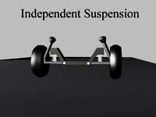
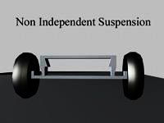
FIGURES SHOW DIFFERENCE BETWEEN INDEPENDENT AND NON INDEPENDENT SUSPENSIONS

Slide 17
ADVANTAGES
Comfort to passengers
Good handling
Shields the vehicle from damage
Increases life of vehicle
Keeps the tires pressed firmly to ground

Slide 18
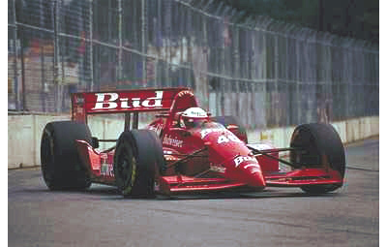
SPECIALISED SUSPENSIONS
FORMULA ONE
MULTI –LINK
SUSPENSION

Slide 19
MORDERN TECHNOLOGY
Hydraulic fluid and air suspension
Electronic and active suspensions

Slide 20
CONCLUSION
From the whole discussion in suspension system, I observe that suspension system is like a white blood cell .As white blood cell provides energy to our body to fight against diseases or viruses which try to destroy or try to decrease our life ,in the similar way suspension system provides the energy to a vehicle to protect itself from damaging, increasing life of the vehicle ,increases the handing,increases comfort of passengers and many more.
So, according to me if you remove the suspension system, then you feel like in bull- cart in Audi , Mercedes types luxurious cars. The only difference is speed.
So, the scope of Suspension System is Too Bright.

Slide 21
THANKS

